Slide 1
8255 PPI
PPI
Programmable Peripheral Interface
‹#›

Slide 2
Intel 8255 PPI
PPI – Programmable Peripheral Interface It is an I/O port chip used for interfacing I/O devices with microprocessor Very commonly used peripheral chip Knowledge of 8255 essential for students in the Microprocessors lab for Interfacing experiments
‹#›

Slide 3
8255 PPI contd.
3 ports in 8255 from user’s point of view - Port A, Port B and Port C. Port C composed of two independent 4-bit ports - PC7-4 (PC Upper) and PC3-0 (PC Lower)
A1 | A0 | Selected port
0 | 0 | Port A
0 | 1 | Port B
1 | 0 | Port C
1 | 1 | Control port
‹#›

Slide 4
PIO
It has 24 I/O lines which are individually programmed in two groups of 12 lines each or 3 groups of eight lines.
2 groups of I/O pins are named as group A and Group B.
Group A contains 8 bit Port A PA0 – PA7 and 4 bit port C PC7-PC4
Group B contains 8 bit Port B PB0 – PB7 and 4 bit port C PC3-PC0.
The Port C Upper and Lower can be used in combination as an 8 bit Port C.

Slide 5
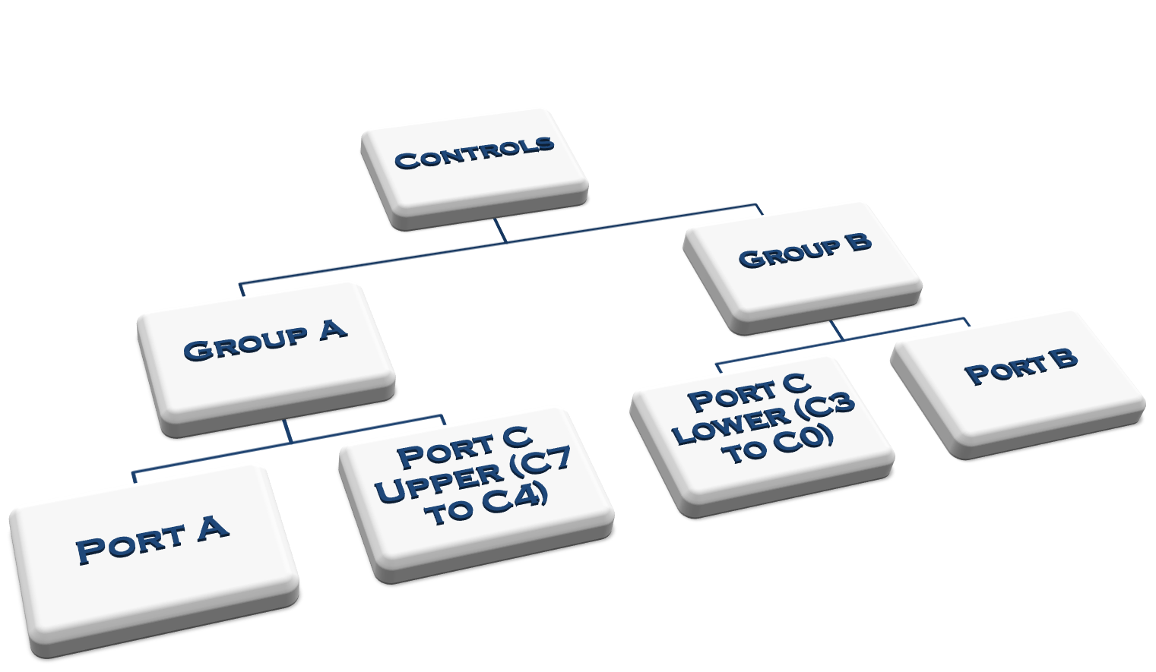
8255 -PPI
Programmable Peripheral Interface

Slide 6
All these ports can function independently either as input or as output ports.
This can be achieved by programming the bits of an internal register of 8255 called as Control Word Register CWR.
The read/write control logic manages all of the internal and external transfer of both data and control word.
The 8 bit, 3 state bidirectional buffer is used to interface the 8255 internal data bus with the external system data bus.

Slide 7
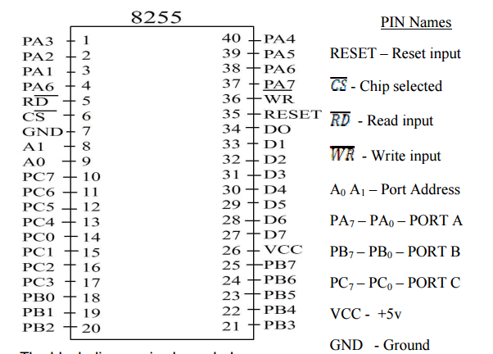
Pin diagram

Slide 8
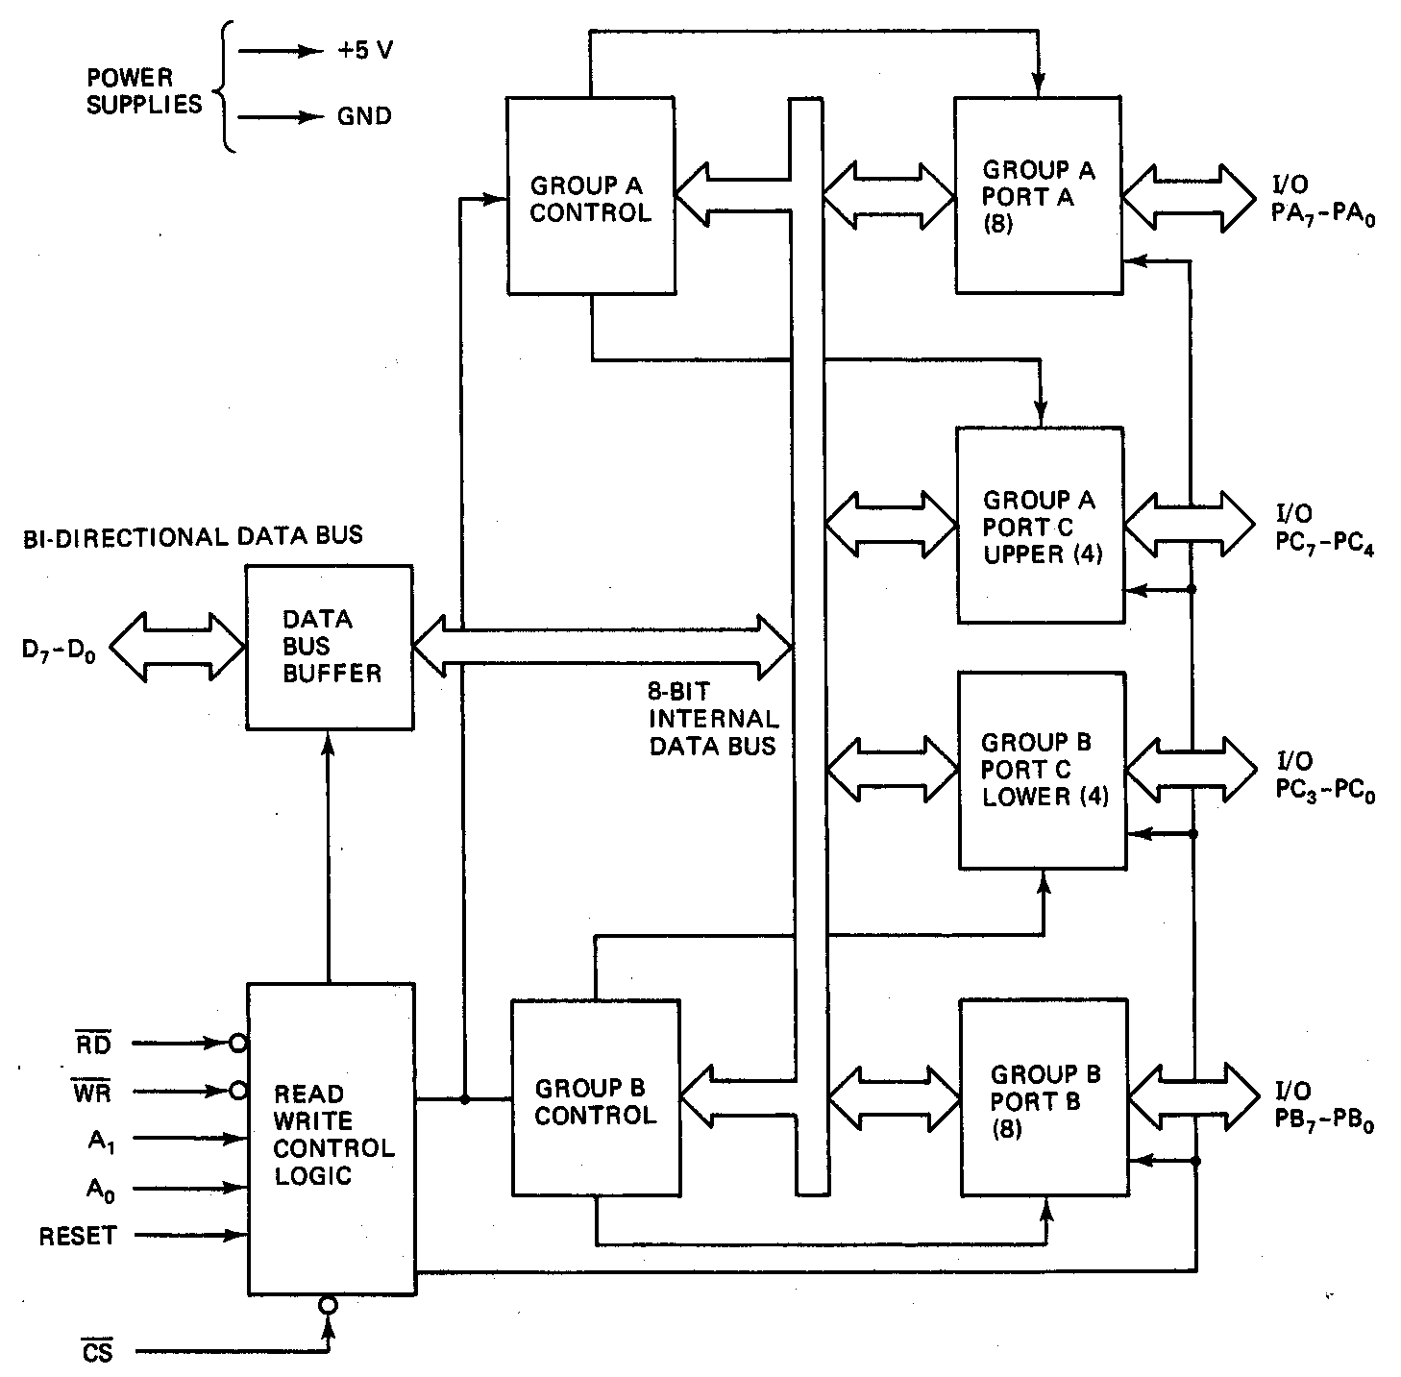
8255 Programmable Peripheral Interface (cont.)

Slide 9
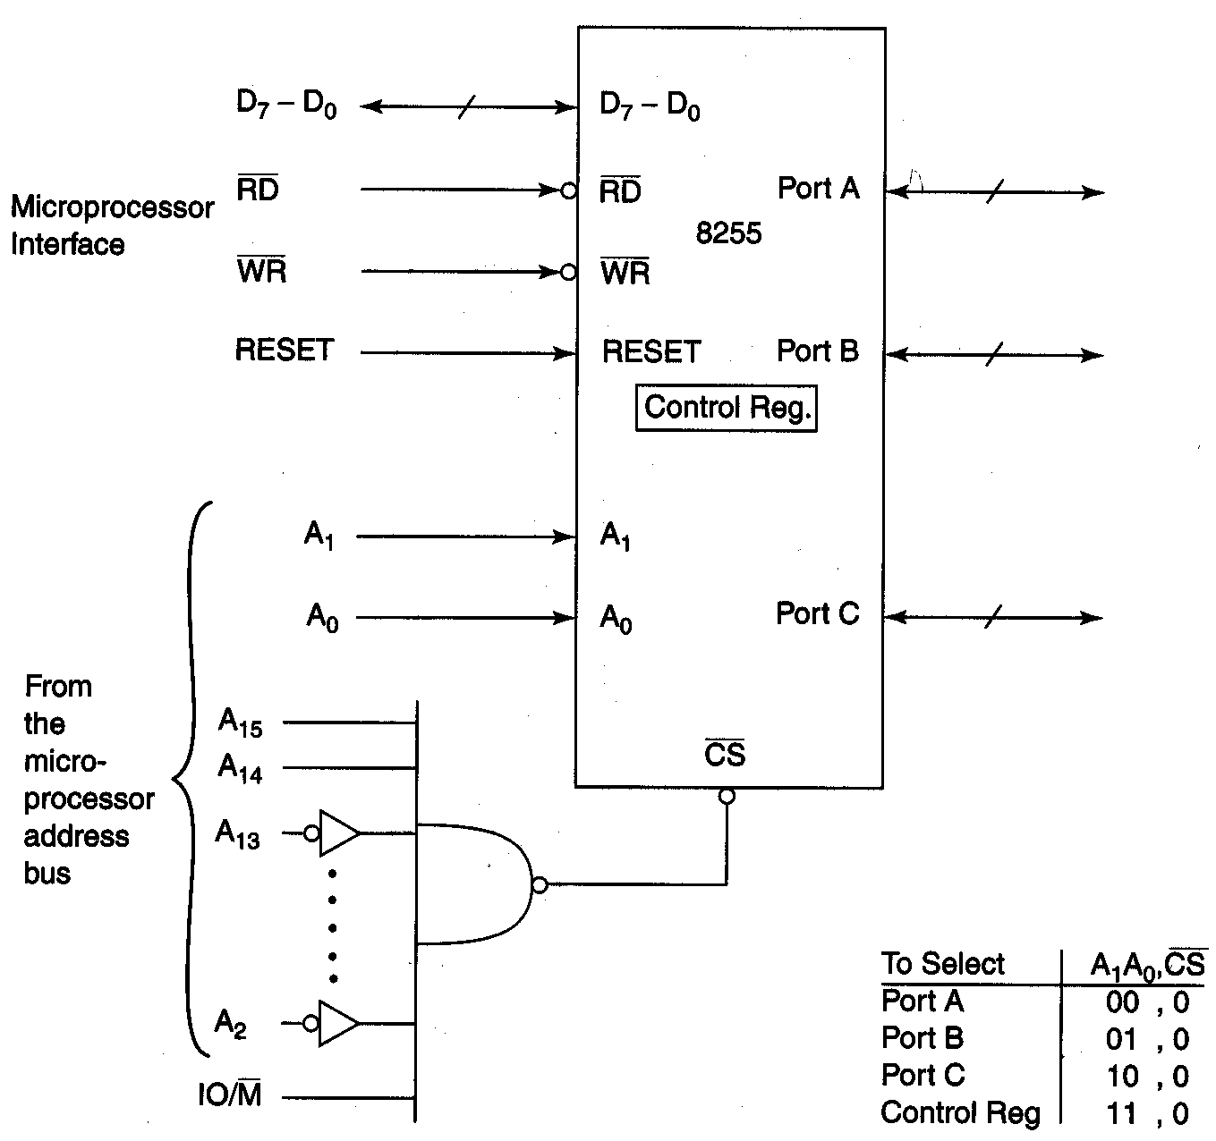
82C55A Programmable Peripheral Interface (cont.)

Slide 10
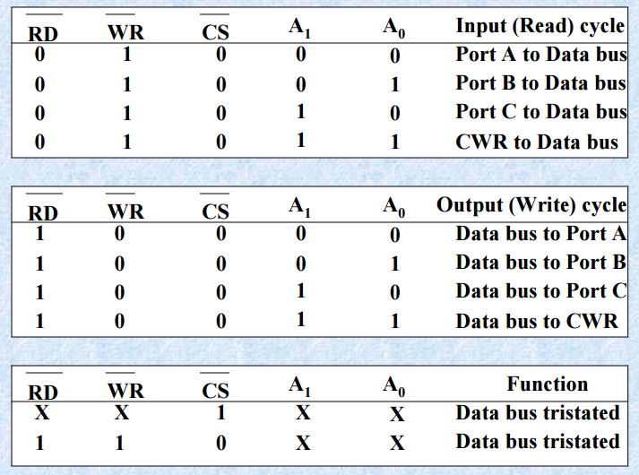
Control Word Register

Slide 11
8255 –PPI Modes of Operation
Programmable Peripheral Interface
Modes
BSR
BIT SET-REST
I/O MODE
MODE 0
Basic I/O Mode
MODE 1
Strobed I/O Mode
MODE 2
Strobed Bidirectional
I/O

Slide 12
Modes of operation of 8255
There are two modes of operation of 8255
I) I/O mode and
II) Bit Set Reset Mode (BSR)
I/O mode work as programmable I/O ports while BSR mode only port C (PC0 to PC7) can be used to set and reset its individual port bits.
Under I/O mode there are 3 modes
mode 0
mode 1 and
mode 2.

Slide 13
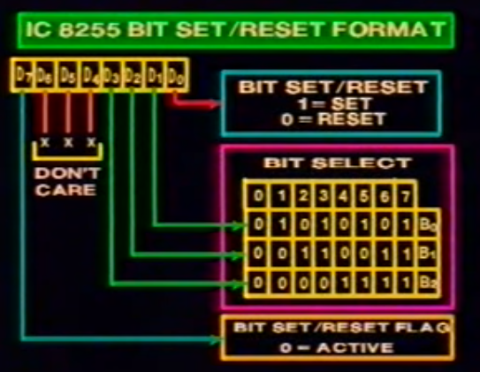

Slide 14
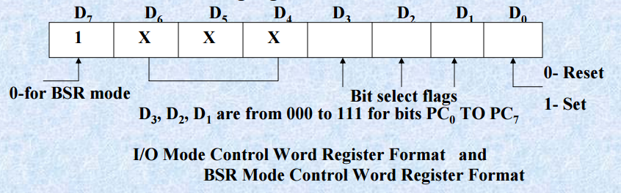
BSR MODE

Slide 15
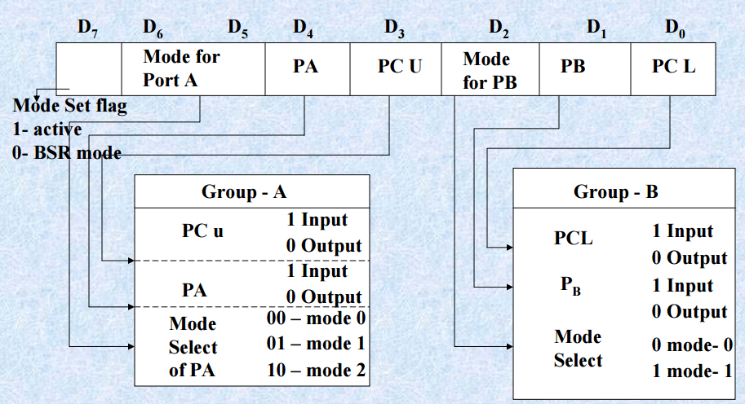
I/O Mode

Slide 16
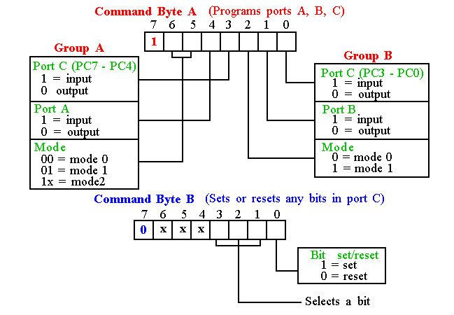
Programming 82C55

Slide 17
8255 PPI Contd.
Mode 0: Simple Input or Output
In this mode, ports A, B are used as two simple 8-bit I/O ports
port C as two 4-bit ports.
Each port can be programmed to function as simply an input port or an output port. The input/output features in Mode 0 are as follows.
1. Outputs are latched. 2. Inputs are not latched. 3. Ports don’t have handshake or interrupt capability.
‹#›

Slide 18
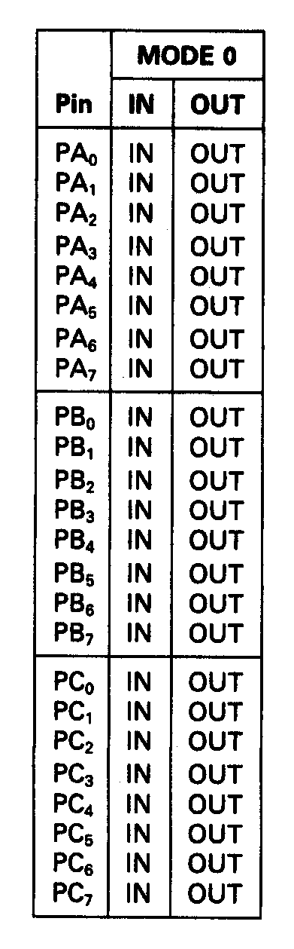
82C55A Programmable Peripheral Interface (cont.)
Mode 0 – Simple I/O operation
Mode 0 port pin functions

Slide 19
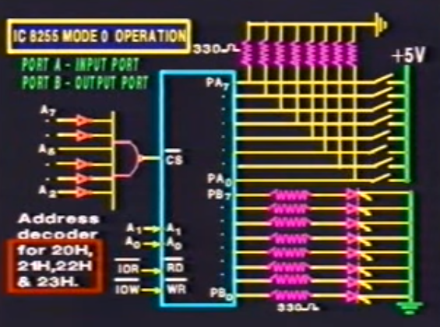
Example –Mode 0

Slide 20
8255 PPI Contd.
Mode 1: Input or Output with Handshake In this mode, handshake signals are exchanged between
the MPU and peripherals prior to data transfer.
The features of the mode include the following: 1. Two ports (A and B) function as 8-bit I/O ports.
They can be configured as either as input or output ports. 2. Each port uses three lines from Port C as handshake signals.
The remaining two lines of Port C can be used for simple I/O operations. 3. Input and Output data are latched. 4. Interrupt logic is supported.
‹#›

Slide 21
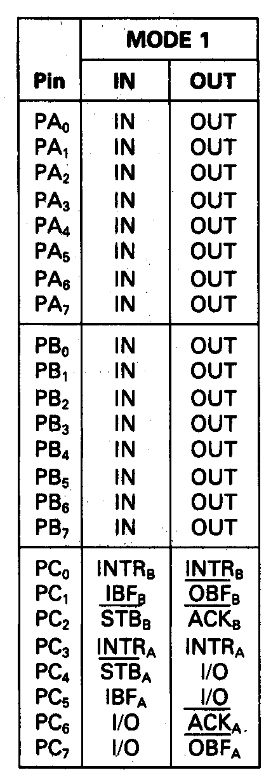
Mode 1 – Strobed I/O

Slide 22
Handshake interrupt i/p port
When i/p device has data to send it checks if IBF (input buffer full) signal is 0.
If 0, it sends data on PB7-0 and activates STB* (Strobe) signal. STB* is active low.
When STB* goes high, the data enters the port and IBF gets activated.
If the Port interrupt is enabled, INT is activated. This interrupts the processor.
Processor reads the port during the ISS. Then IBF and INT get deactivated.
‹#›

Slide 23
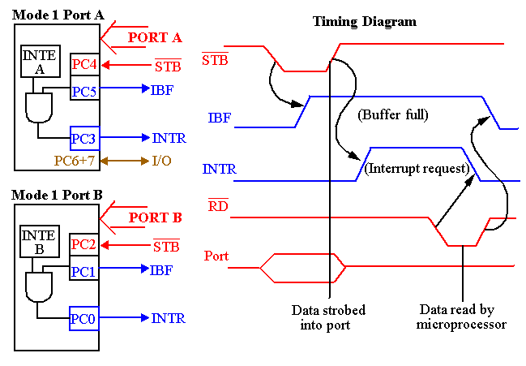
82C55: Mode 1 Strobed Input
Signal definitions for Mode 1 Strobe Input
Notes:
‹#›

Slide 24
Handshake interrupt o/p port
When o/p device wants to receive data it checks if OBF* (output buffer full) signal is 0.
If 0, it receives data on Port and activates ACK* (Acknowledge) signal. ACK* is active low.
When ACK* goes high, the data goes out of the port and OBF* is set to 1.
If the Port interrupt is enabled, INT is activated. This interrupts the processor.
Processor sends another byte to the port during the ISS. Then OBF* and INT are reset to 0.
‹#›

Slide 25
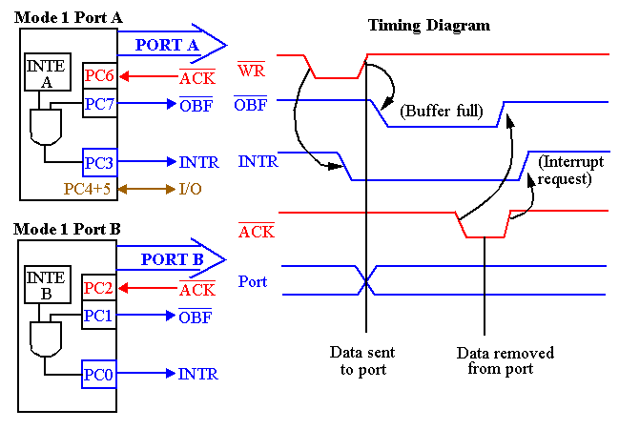
82C55 : Mode 1 Output Exam.
Notes:
‹#›
Similar to Mode 0 output operation, except that handshaking signals are provided using port C.
Signal Definitions for Mode 1 Strobed Output

Slide 26
8255 PPI Contd.
Mode 2: Bidirectional Data Transfer This mode is used primarily in applications such as data transfer
between two computers.
In this mode, Port A can be configured as the bidirectional port
Port B either in Mode 0 or Mode 1.
Port A uses five signals from Port C
as handshake signals for data transfer.
The remaining three signals from port C can be used either
as simple I/O or as handshake for port B.
‹#›

Slide 27
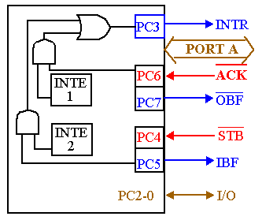
82C55: Mode 2 Bi-directional Operation
Timing diagram is a combination of the Mode 1 Strobed Input and Mode 1 Strobed Output Timing diagrams.

Slide 28
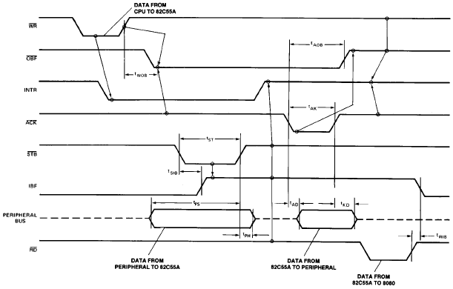
Mode 2 Timing Diagram

Slide 29
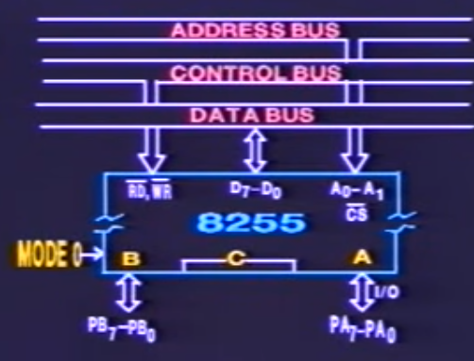
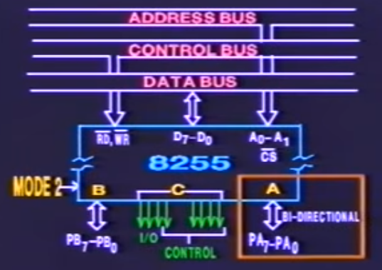
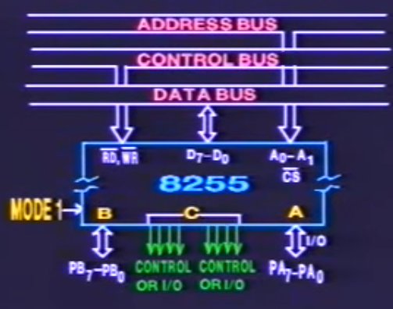
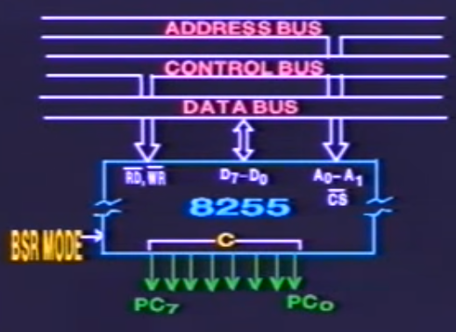

Slide 30
82C55A Programmable Peripheral Interface (cont.)
EXAMPLE:
What is the mode and I/O configuration for ports A, B, and C of an 82C55A after its control register is loaded with 82₁₆?
Solution:
Expressing the control register contents in binary
form, we get
D₇D₆D₅D₄D₃D₂D₁D₀ = 10000010₂
Since D₇ is 1, the modes of operation of the ports
are selected by the control word.
D₀ = 0 Lower four bits of port C are outputs.
D₁ = 1 Port B is an input port.
D₂ = 0 Mode 0 for both port B and the lower four bits of port C.

Slide 31
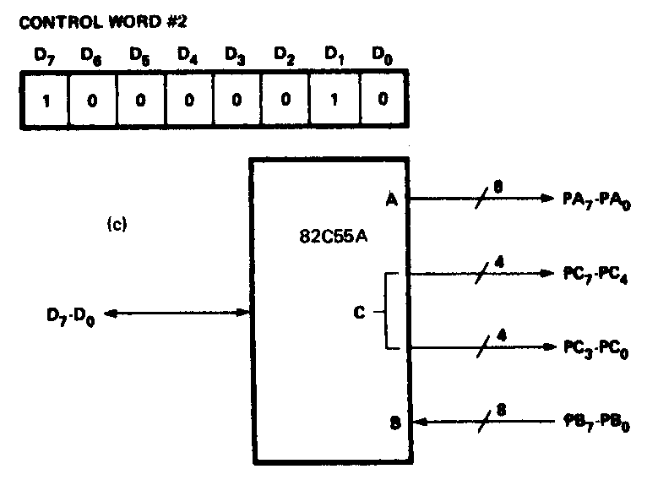
82C55A Programmable Peripheral Interface (cont.)
The next for bits configure the upper part of port C and port A:
D₃ = 0 Upper four bits of port C are outputs.
D₄ = 0 Port A is an output port.
D₆D₅ = 00 Mode 0 for both port A and the upper four bits of port C

Slide 32
8255 MD Control word Contd.
Ex. 1: Configure Port A as i/p in Mode 0, Port B as o/p in mode 0, Port C (Lower) as o/p and Port C (Upper) as i/p ports.
Required MD control word:
 |  | 1 | 0 | 0 | 1 | 1 | 0 | 0 | 0 | = |  | 98H
MD control |  |  |  |  |  |  |  |  | PC Lower as o/p
 | PA in Mode 0 |  |  |  |  |  |  | PB as o/p Reqd. instrns.
 |  | PA as i/p |  |  |  |  | PB in Mode 0 |  |  |  | MOV AL, 98H
 |  |  |  |  |  | PC Upper as i/p |  |  |  |  | OUT 7FH, AL
‹#›

Slide 33
8255 MD Control word Contd.
Ex. 2: Configure Port A as i/p in Mode 1, Port B as o/p in mode 1, Port C7-8 as i/p ports. (PC5-0 are handshake lines, some i/p lines and others o/p. So they are shown as X)
Required MD control word:
 |  | 1 | 0 |  | 1 | 1 | 1 | 1 | 0 | X | = |  | BCH or BDH
MD control |  |  |  |  |  |  |  |  |  | PC3-0 as don’t care
 | PA in Mode 1 |  |  |  |  |  |  |  | PB as o/p Reqd. Instrns.
 |  | PA as i/p |  |  |  |  |  | PB in Mode 1 |  |  |  | MOV AL,BCH
 |  |  |  |  |  | PC Upper(C7-8) as i/p |  |  |  |  |  | OUT 7FH, AL
‹#›

Slide 34
8255 MD Control word Contd.
Ex. 3:Configure Port A in Mode 2, Port B as o/p in mode 1. (PC5-0 are handshake lines for Port A and PC2-0 are handshake signals for port B)
Required MD control word:
 |  | 1 | 1 | 0 | X | X | 1 | 0 | X | = |  | C4H / C5H..
MD control |  |  |  |  |  |  |  |  | PC3-0 as handshake
 | PA in Mode 2 |  |  |  |  |  |  | PB as o/p Reqd. instrns.
 | PA bidirectional |  |  |  |  |  | PB in Mode 1 |  |  |  | MOV AL, C4H
 |  |  |  | PC7-0 as handshake |  |  |  |  |  |  | OUT 7FH, AL
‹#›

Slide 35
8255 PCBSR Control word
Control port having Port C Bit Set / Reset control word
 |  | 0 | X | X | X | SB2 |  | SB1 |  | SB0 |  | S/R*
PC bit set / reset control word |  |  |  |  |  | Select bit of PC to be set / reset |  |  |  |  |  | 1 - Set to 1 0 - Reset to 0
 |  |  | Don’t cares
 |  |  |  |  |  | 0 | 0 |  | 0 |  | Bit 0 of Port C
 |  |  |  |  |  | 0 | 0 |  | 1 |  | Bit 1 of Port C
 |  |  |  |  |  |  | :
 |  |  |  |  |  |  | :
 |  |  |  |  |  | 1 | 1 |  | 1 |  | Bit 7 of Port C
‹#›

Slide 36
8255 PCBSR Control word contd.
Ex. 2: Reset to 0 bit 6 of Port C
 |  | 0 | X | X | X | 1 |  | 1 |  | 0 |  | 0 | = | 0CH,…
PC bit set / reset control word |  |  |  |  |  | Bit 6 of PC |  |  |  |  |  | Reset to 0
 |  |  | Don’t cares
 |  |  |  |  |  |  |  |  |  |  | Required instructions
 |  |  |  |  |  |  |  |  |  |  | MOV AL, 0CH
 |  |  |  |  |  |  |  |  |  |  | OUT 7FH, AL
‹#›

Slide 37
8255 PCBSR Control word contd.
Ex. 1: Set to 1 bit 4 of Port C
 |  | 0 | X | X | X | 1 |  | 0 |  | 0 |  | 1 | = | 09H,…
PC bit set / reset control word |  |  |  |  |  | Bit 4 of PC |  |  |  |  |  | Set to 1
 |  |  | Don’t cares
 |  |  |  |  |  |  |  |  |  |  | Required instructions
 |  |  |  |  |  |  |  |  |  |  | MOV AL, 09H
 |  |  |  |  |  |  |  |  |  |  | OUT 7FH, AL
‹#›

Slide 38
8255 Handshake signals
Where are the Handshake signals? Port C pins act as handshake signals, when Port A and Port B are configured for other than Mode 0. Port A in Mode 2 and Port B in Mode 1 is possible, as it needs only 5+3 = 8 handshake signals After Reset of 8255, Port A , Port B , and Port C are configured for Mode 0 operation as input ports.
‹#›

Slide 39
8255 Handshake signals Contd.
PC2-0 are used as handshake signals by Port B when configured in Mode 1. This is immaterial whether Port B is configured as i/p or o/p port. PC5-3 are used as handshake signals by Port A when configured as i/p port in Mode 1. PC7,6,3 are used as handshake signals by Port A when configured as o/p port in Mode 1. PC7-3 are used as handshake signals by Port A when configured in Mode 2.
‹#›

Slide 40
8255 PPI Contd.
Port A can work in Mode 0, Mode 1, or Mode 2 Port B can work in Mode 0, or Mode 1 Port C can work in Mode 0 only, if at all Port A, Port B and Port C can work in Mode 0 Port A and Port B can work in Mode 1 Only Port A can work in Mode 2
‹#›

